Slide 1
Intro to Design Patterns
Lecture 3.2 – Decorator Pattern

Slide 2
Reading
DPE
Chapter 17 – The Decorator Pattern

Slide 3
If the Options are varying use the Decorator pattern
Technique
All sub classes of the decorator class have a pointer to the client class.
The decorator class inherits from the client class.
Chain options together through the constructor (ctor).
Smart pointers strongly recommended if allocating objects off the heap.
Benefits
Client code uses classes polymorphically.
Follows open/closed principle.
Follows DRY principle.
Avoids combinatorial explosion.

Slide 4
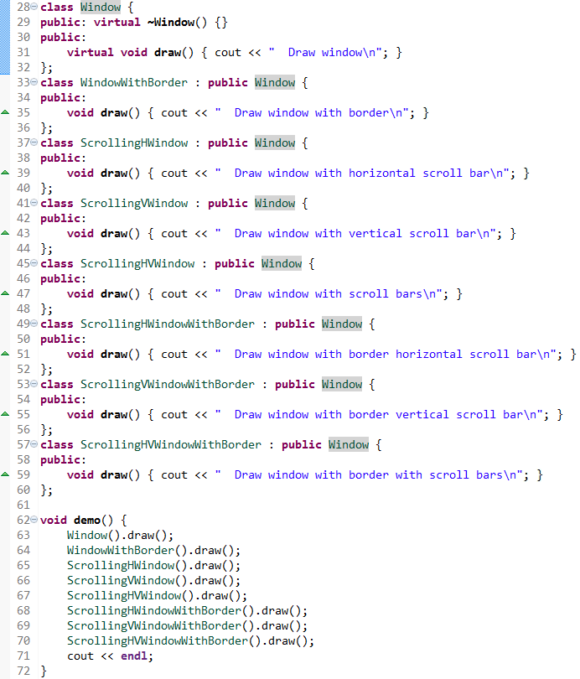
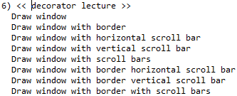
Problem Example
Notes:
Subclassing by window features leads to combinatorial explosion.
Subclassing occurs at compile time.

Slide 5
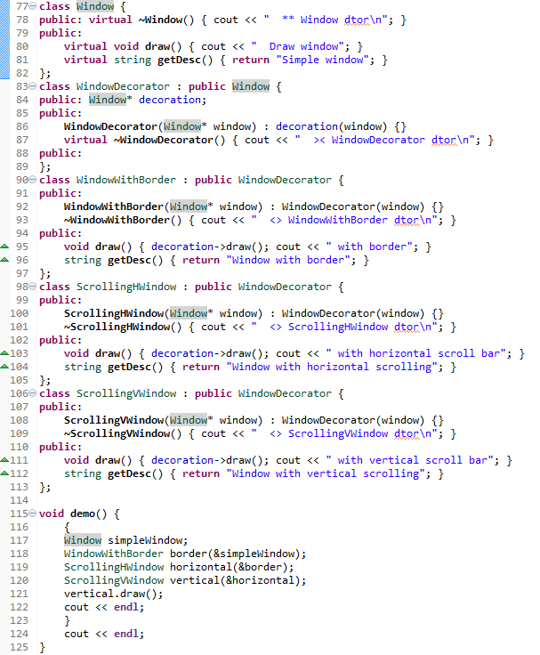
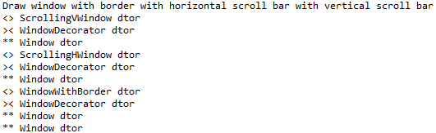
Solution Example
Notes:
Note the structure of the destructor sequences.
Note use of objects off the stack – can also allocate off the heap, but requires different cleanup code.

Slide 6
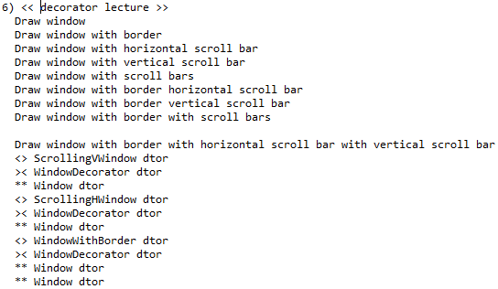
Output
Notes:
Note how the dtor unwinds the objects.

Slide 7
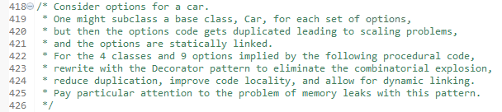
Homework

Slide 8
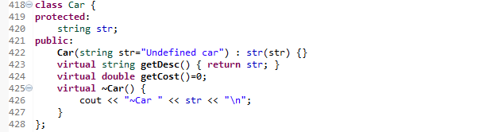
Code Common to Examples

Slide 9
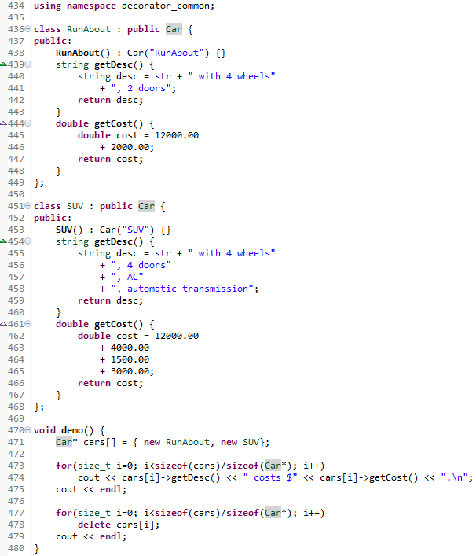
Legacy Example

Slide 10
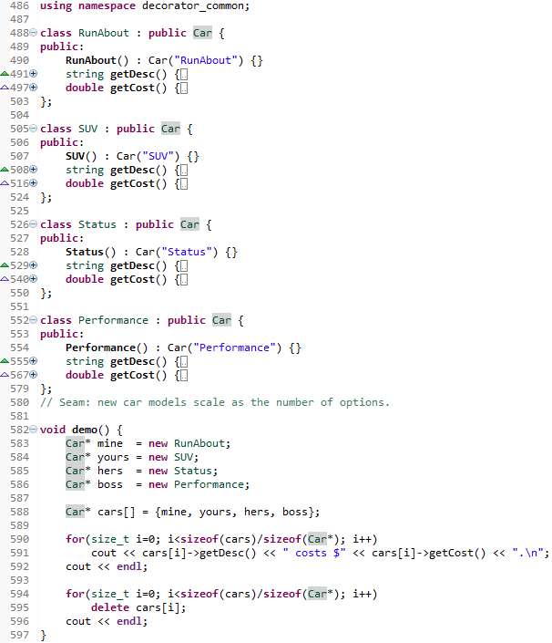
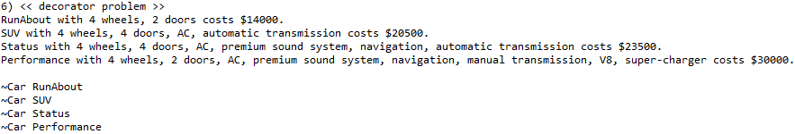
Problem Example

Slide 11
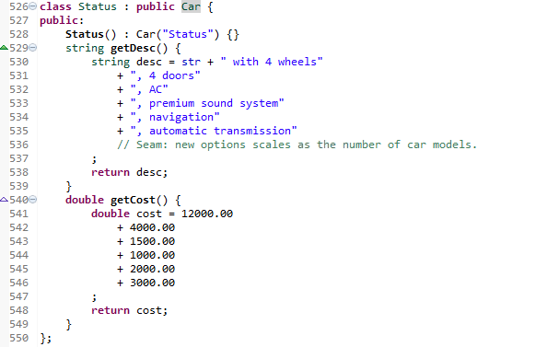
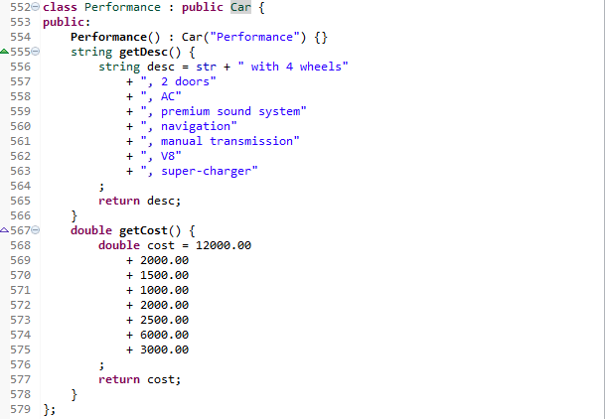
Problem Example cont.

Slide 12
Summary
When the options are varying, use the Decorator pattern to encapsulate the variations.
Implement a decorator class which inherits from the client class.
Single inheritance hierarchy with the decorator class as the base class.

Slide 13
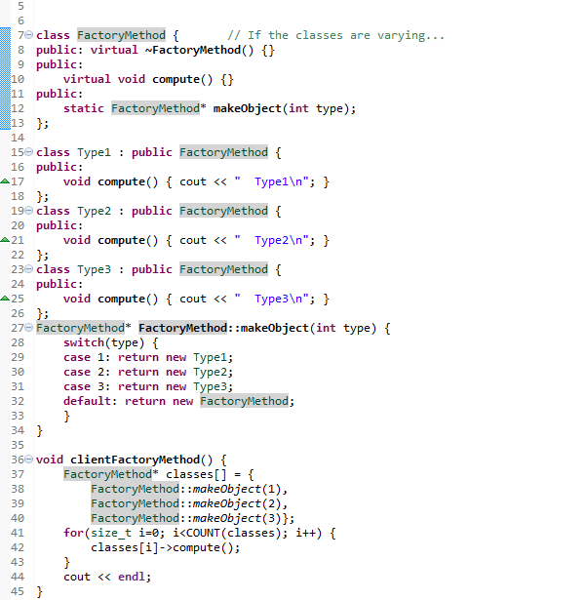
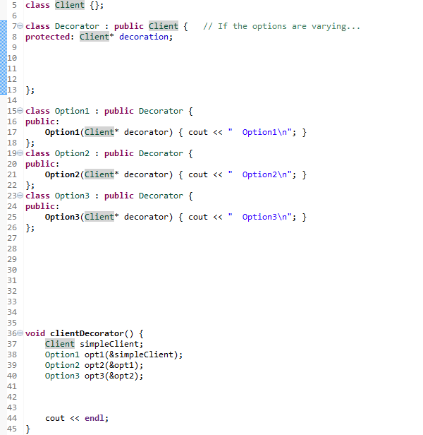

Slide 14
Class Progress
If the algorithms are varying
If the interfaces are varying
If the API’s are varying
If the steps are varying
If the classes are varying
If the options are varying
If the listeners are varying
If the responders are varying
If abstract’n & implement’n vary
If the families are varying
Use the Strategy pattern
Use the Adapter pattern
Use the Facade pattern
Use the Template Method pattern
Use the Factory Method pattern
Use the Decorator pattern
Use the Observer pattern
Use Chain of Responsibility pattern
Use the Bridge pattern
Use the Abstract Factory pattern

Slide 15
Backup Slides

Slide 16


